Slide 1


Open Scholarship, Licensing, and Data Management
Bootcamp
MA Digital Text Analysis
Wout Dillen

Slide 2
Today’s Class
Open Source
Open Access
Licensing
Open Scholarship
Research Data Management

Slide 3
Open Source

Slide 4
Open Source Software
What is open source software?
What is open source software?
Computer software where the source code is made freely available by those who have (and keep) the copyright.
What is open source software?
Computer software where the source code is made freely available by those who have (and keep) the copyright.

Slide 5


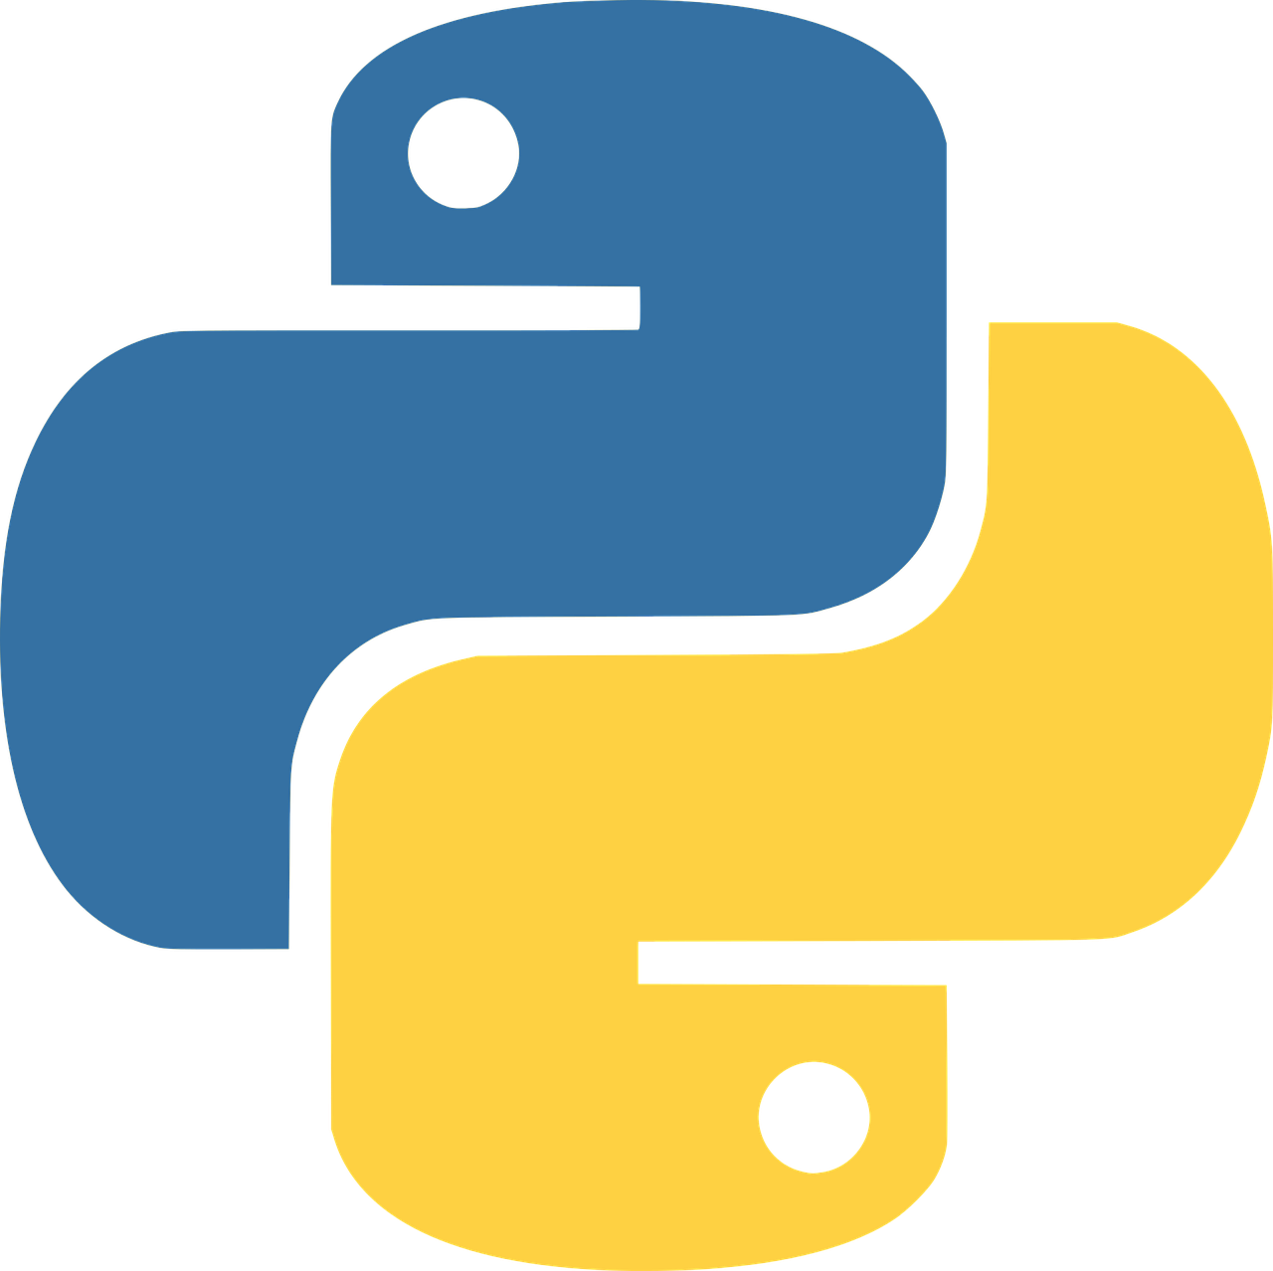

Open Source Software
What is open source software?
What is open source software?
Computer software where the source code is made freely available by those who have (and keep) the copyright.
What is open source software?
Computer software where the source code is made freely available by those who have (and keep) the copyright.
Source Code | Executable Code
Created by the programmer. | Created by the Compiler.
Text rich document. | Series of binary digits.
Human Readable. | Machine Readable.
Not system specific. | System specific.
source
code
compiler
executable code

Slide 6
Open Source Software
What is open source software?
Computer software where the source code is made freely available by those who have (and keep) the copyright.
Free to:
Read
Copy
Reuse
Modify
Share

Slide 7
Open Source Software
What is open source software?
Computer software where the source code is made freely available by those who have (and keep) the copyright.

Slide 8
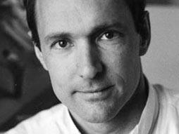
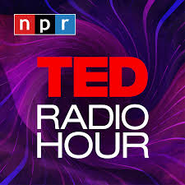

The World Wide Web as an Open Source Project
In the 1980s, scientists at a nuclear research lab in Switzerland were asking how they could share and collaborate on massive, complex projects. Tim Berners-Lee, then a contractor, answered by inventing the World Wide Web.
Tim Berners-Lee
TED Radio Hour Podcast:
Open Source World
https://n.pr/2GMa0Mg

Slide 9
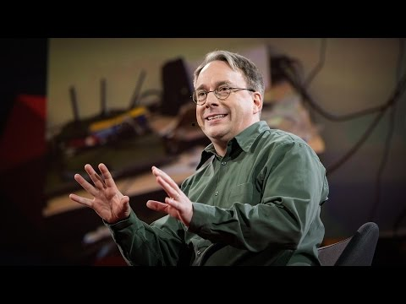
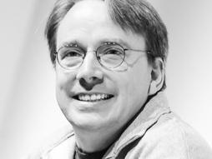
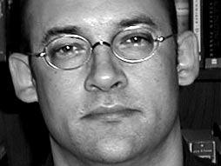
Open Source Computing with Linux
Linus Torvalds
Clay Shirky
TED Radio Hour Podcast:
Open Source World
https://n.pr/2GMa0Mg
TED Talk: The Mind Behind Linux

Slide 10
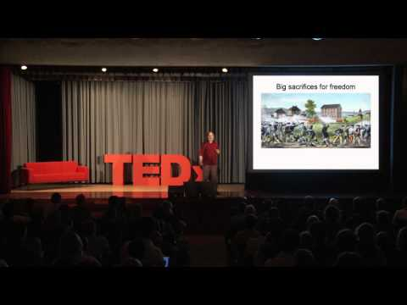
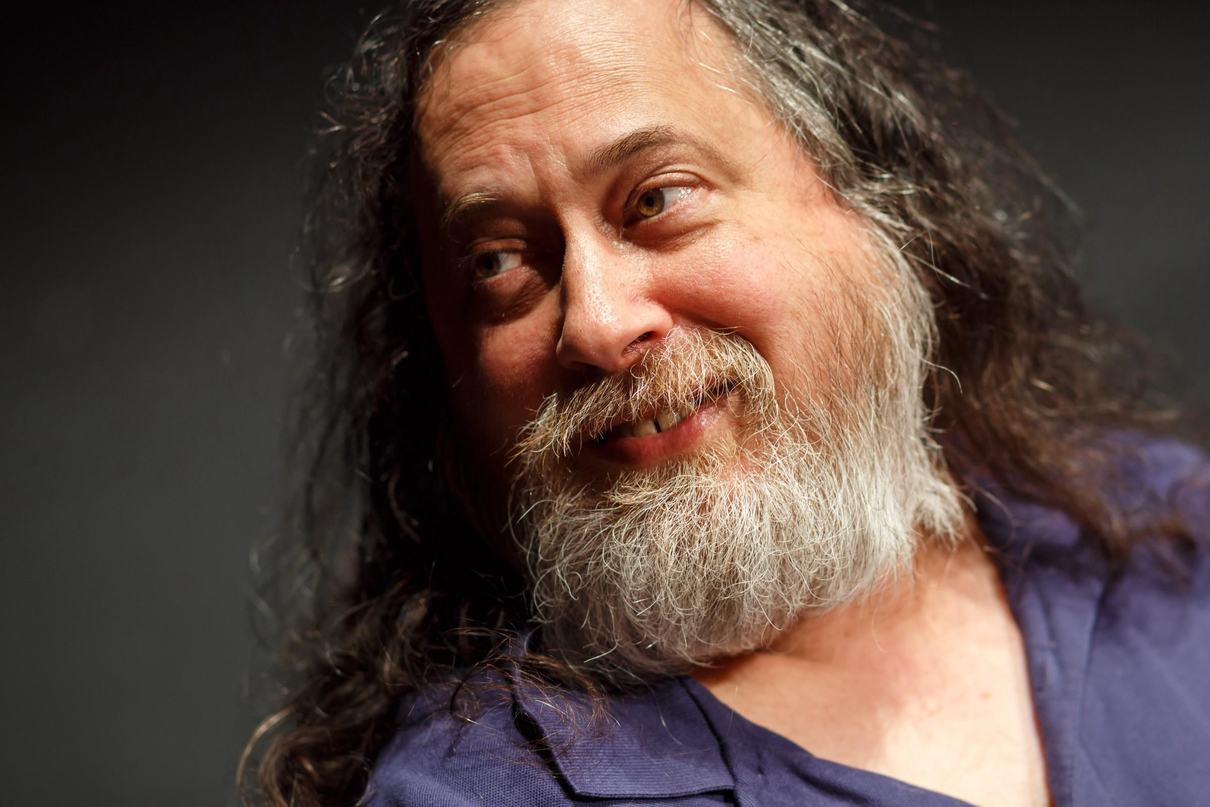
The Free Software Movement (GNU/Linux)
Richard M. Stallman
Free software” is a matter of liberty, not price. To understand the concept, you should think of “free” as in “free speech,” not as in “free beer”.
(Stallman 2002, 3)
TEDx Talk: Free Software, Free Society

Slide 11
Open Source in Academia
Why would the principles of Open Source be useful for academia?
Accountability
Reproducibility
Redundancy
Reusability
Progress

Slide 12
Open Access

Slide 13
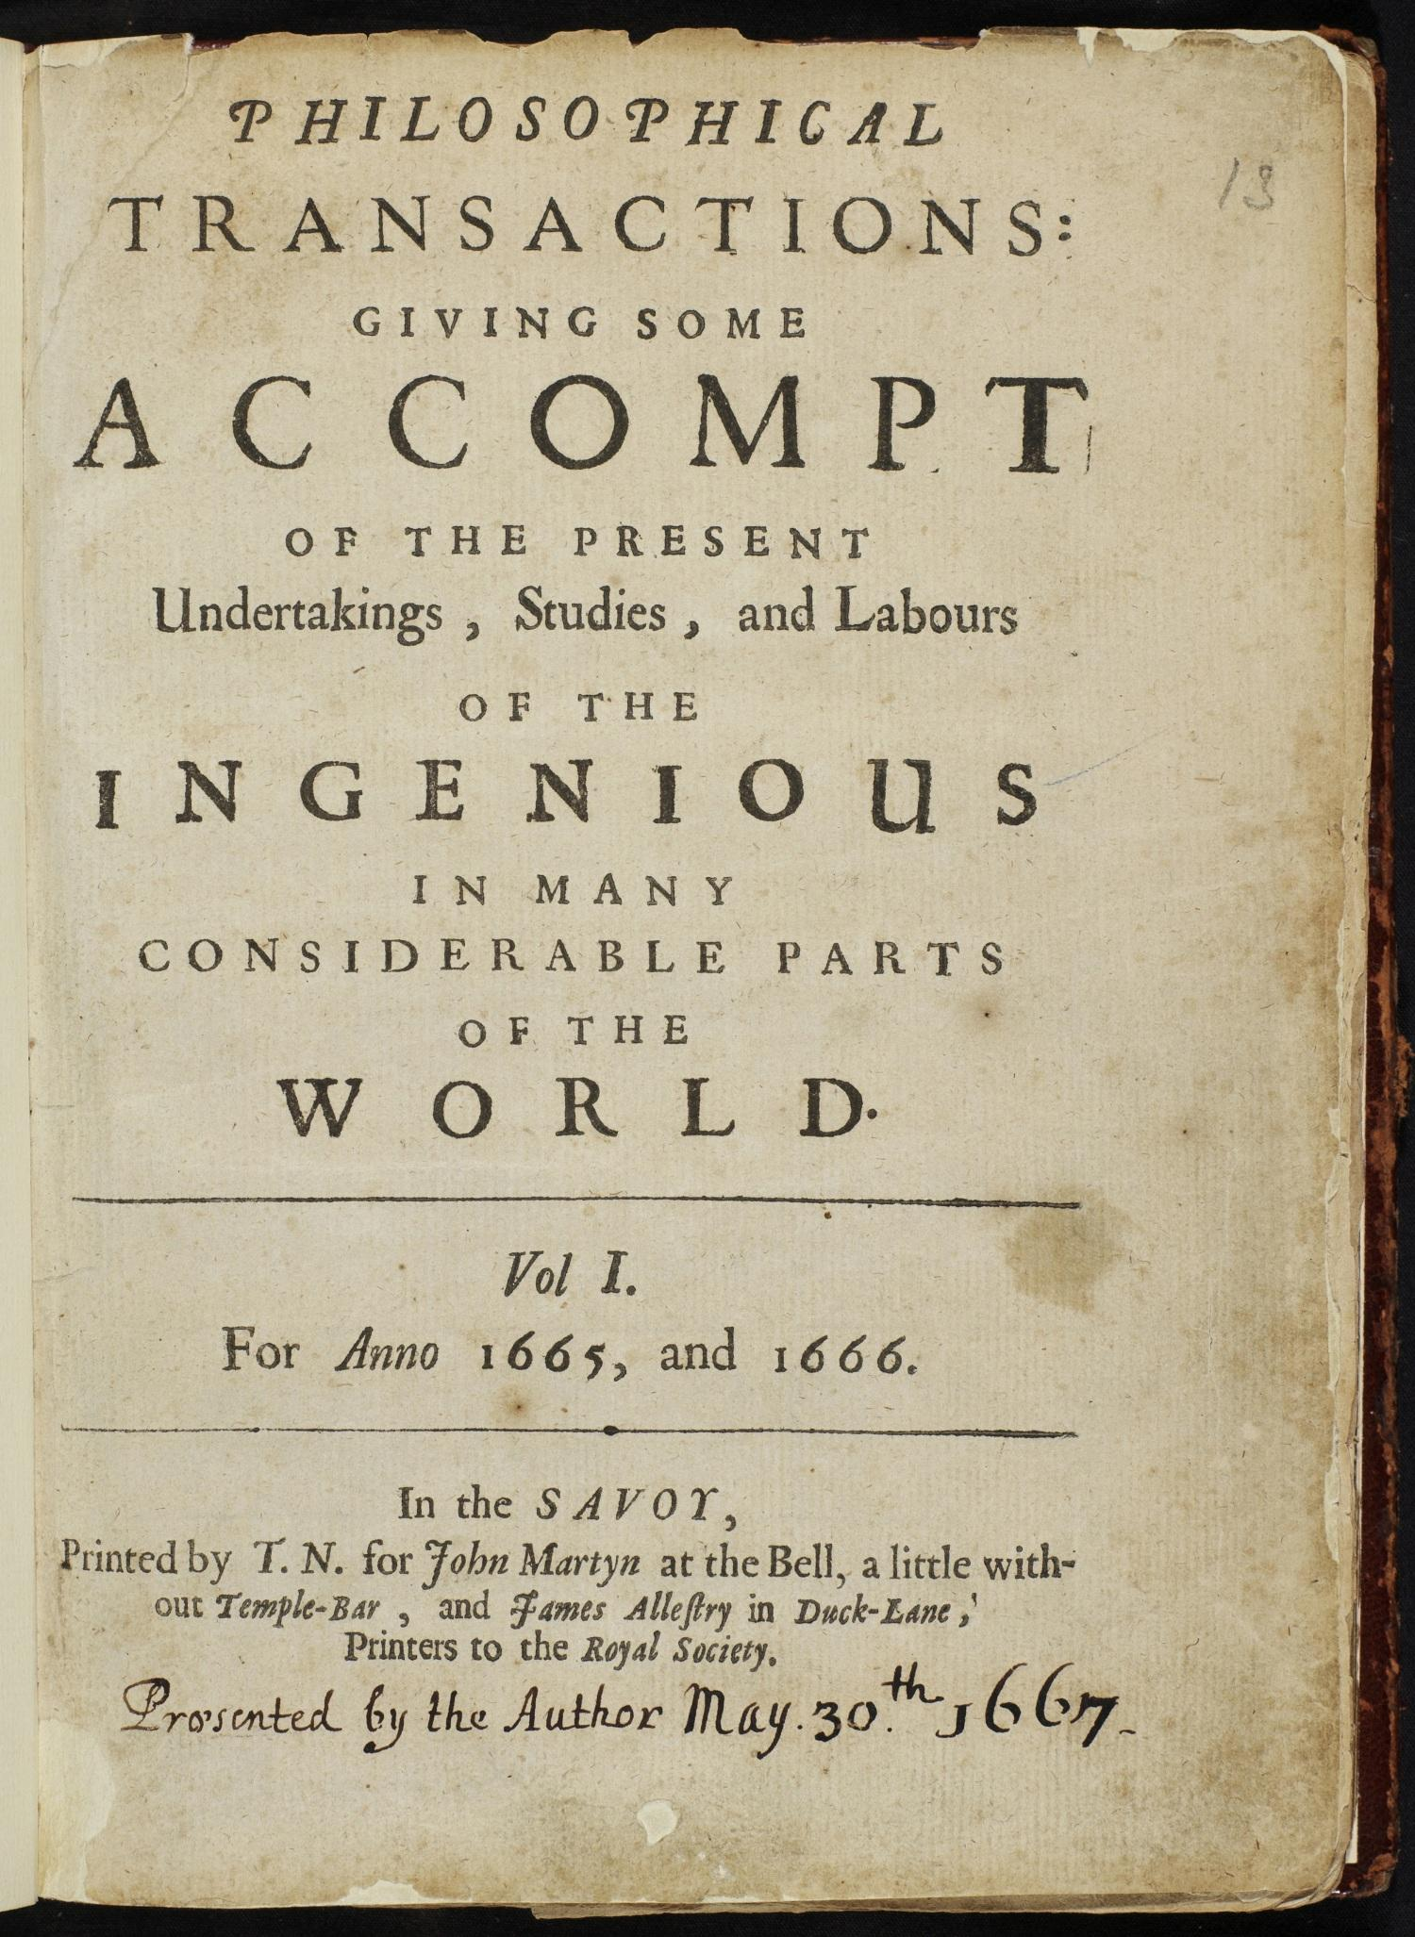
The Birth of Scientific Journals
Philosophical Transactions (Vol. 1, 1665)
Openness (accountability, reproducibility, etc.)
Speed
Progress
Clay Shirky
TED Radio Hour Podcast:
Open Source World
https://n.pr/2GMa0Mg

Slide 14





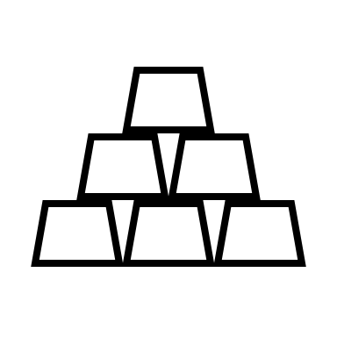

Academic Journals as a Business

Slide 15

Open Access
By "open access" to this literature, we mean its free availability on the public internet, permitting any users to read, download, copy, distribute, print, search, or link to the full texts of these articles, crawl them for indexing, pass them as data to software, or use them for any other lawful purpose, without financial, legal, or technical barriers other than those inseparable from gaining access to the internet itself. The only constraint on reproduction and distribution, and the only role for copyright in this domain, should be to give authors control over the integrity of their work and the right to be properly acknowledged and cited.
(Budapest Open Access Initiative, 2002)

Slide 16
Open Access Benefits
The integrity and quality of research increase because research methods become more transparent and scientific results are easier to verify and reproduce.
The scholarly community
can collaborate better when research results are available immediately and worldwide. Working together ensures diverse and creative interpretations of the results and reduces research costs, since researchers can build on previously obtained results. All this leads to more innovation and a rapid increase of knowledge.​​​​​​
wins back control over the scholarly output, as they become less dependent on large commercial publishers.
Researchers gain impact, thanks to OA they increase the visibility of their work and the chances of their output actually being used (cited, downloaded).
Researchers of less wealthy institutions gain more access to academic work, which decreases the current inequality.
The public sees for which purposes public funds are being used and enthusiasts outside the academic community can become active partners in scientific research.
(KU Leuven, Open Access Why and How)

Slide 17

Flavours of Open Access
Green Open Access
You publish your work behind a paywall and self-archive a digital copy in a free online repository, where everyone can access it. Keep in mind:
That you are rarely allowed to make the published version of your paper available in OA.
That you are always allowed (according to Belgian OA legislation) to make the accepted version of a journal article available in OA, if necessary after an embargo period.
That you are always allowed to make the submitted version available in OA, but keep in mind that this version has not been peer reviewed.
Always check the self-archiving policy of the journal where you have published in or are going to publish in. A useful website for checking publisher’s archiving policies is Sherpa Romeo.
Gold Open Access
You can publish your article or book immediately in OA, making the published version of your work available to the public. The reader does not have to pay for access.
Because the publication costs are no longer covered by sales of the finished product, publishers have to find other financial resources. There are two options:
For-profit Gold OA: the authors (or the institutions for which they work) pay for the publishing costs, also called author fees (taking into account profit margins).
Non-profit Gold OA: either the authors (or the institutions for which they work) pay author fees which are calculated to represent the true cost of publishing; or the publishing infrastructure is subsidized, so that neither authors nor readers need to pay. A strict version of non-profit Gold OA is Fair OA.

Slide 18


Free as in Free Beer?
Free software is a matter
of liberty, not price. [T]hink of
‘free’ as in ‘free speech,’ not as in
‘free beer.’
(Stallman 2002, 3)

Slide 19



Free as in Free Beer?

Slide 20

Free as in Free Beer?

Slide 21

Free as in Free Beer?
Share Experiences
Share Templates
Share Workflows
Share Workload

Slide 22


DH Benelux Journal
Share the workload with the community
guest editors
templates & pipelines
authors

Slide 23
Licensing

Slide 24
Licensing: Basics
What can be licensed?
any “work”
...that you own the rights to
to be considered: publisher contracts, work contracts, co-authors
What cannot be licensed?
works in the public domain
raw data
What exactly is a license?
a formalized promise not to sue
(Hannesschläger and Scholger 2019)

Slide 25
Licensing with Creative Commons
What is Creative Commons?
Non-profit organization (since 2001)
Provides ready-made open public licenses that can be used by any author who wishes to share their work
Especially useful for licensing “creative content” (not code)
Presently de facto standard for public licensing
Current version: 4.0 http://www.creativecommons.org/
(Hannesschläger and Scholger 2019)

Slide 26
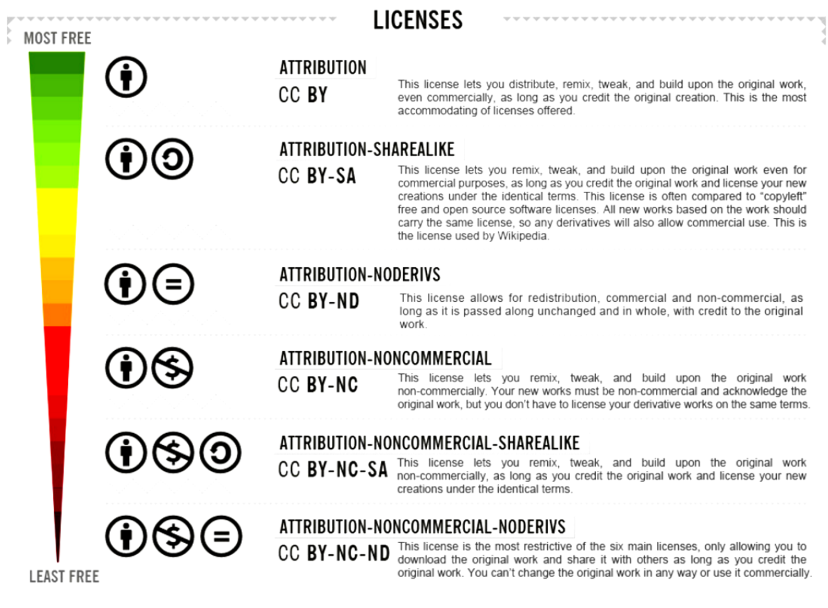
Licensing with Creative Commons
Creative Commons Modules:
attribution > by
copyleft > sa
no derivatives > nd
non-commercial > nc
Keep in mind:
Public Domain Mark vs. CCO
Other licences: GNU GPL, MIT, etc.
Need help? See https://ufal.github.io/public-license-selector/
(Hannesschläger and Scholger 2019)

Slide 27
Open Scholarship

Slide 28
Open EVERYTHING!
Open Source
The source code of the software you use/develop is freely available online.
Open Access
Your scholarly publications are freely available online.
Open Scholarship
Your research, and all the steps you took to get there are transparent and accessible. (FAIR: Findable, Accessible, Interoperable, Reusable).
Open Source
The source code of the software you use/develop is freely available online.
Open Access
Your scholarly publications are freely available online.
Open Scholarship
Your research, and all the steps you took to get there are transparent and accessible. (FAIR: Findable, Accessible, Interoperable, Reusable).
Caveat
As Open as Possible, as Closed as Necessary!

Slide 29
FAIR Data Principles
https://www.force11.org/
TO BE FINDABLE:
F1. (meta)data are assigned a globally unique and eternally persistent identifier.
F2. data are described with rich metadata.
F3. (meta)data are registered or indexed in a searchable resource.
F4. metadata specify the data identifier.
TO BE ACCESSIBLE:
A1 (meta)data are retrievable by their identifier using a standardized communications protocol.
A1.1 the protocol is open, free, and universally implementable.
A1.2 the protocol allows for an authentication and authorization procedure, where necessary.
A2 metadata are accessible, even when the data are no longer available.
TO BE INTEROPERABLE:
I1. (meta)data use a formal, accessible, shared, and broadly applicable language for knowledge representation.
I2. (meta)data use vocabularies that follow FAIR principles.
I3. (meta)data include qualified references to other (meta)data.
TO BE RE-USABLE:
R1. meta(data) have a plurality of accurate and relevant attributes.
R1.1. (meta)data are released with a clear and accessible data usage license.
R1.2. (meta)data are associated with their provenance.
R1.3. (meta)data meet domain-relevant community standards.

Slide 30
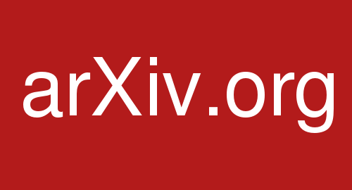
arXiv.org
https://arxiv.org

Slide 31

Humanities Commons
https://hcommons.org

Slide 32

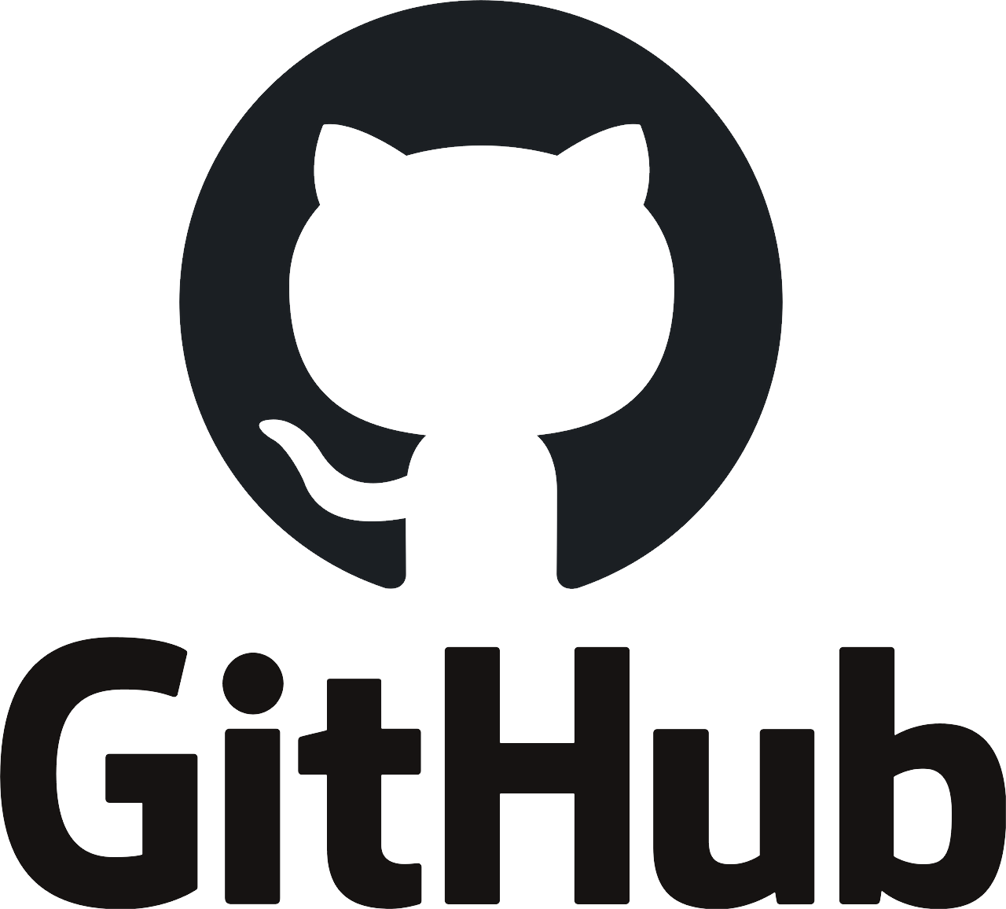
Zenodo
https://zenodo.org

Slide 33
Research Data Management

Slide 34
Research Data Management
Research Data Management describes the process to curate (or manage) research data along the research data lifecycle and includes various activities such as planning, producing, selection, analysis, archiving, and preparation for reuse. Because data are very heterogeneous, discipline and data specific solutions can be required.
(Arbeitsgruppe Forschungsdaten 2018, translated into English in Wutteke 2019)

Slide 35

dmponline.be
https://dmponline.be

Slide 36
References
Chan, Leslie, Darius Cuplinskas, Michael Eisen, Fred Friend, Yana Genova, Jean-Claude Guédon, Melissa Hagemann, et al. “Read the Budapest Open Access Initiative.” Budapest Open Access Initiative, 2002. http://www.budapestopenaccessinitiative.org/read.
Free Software, Free Society: Richard Stallman at TEDxGeneva 2014, 2014. https://www.youtube.com/watch?v=Ag1AKIl_2GM&ab_channel=TEDxTalks.
Hannesschläger, Vanessa. Open Science Basics: Copyright and Licensing, 2019. https://www.youtube.com/watch?v=heUYeiOPJKc&t=1s&ab_channel=ACDH-CHOeAW.
“License Selector.” Accessed October 8, 2020. https://ufal.github.io/public-license-selector/.
“Open Access: Why and How – Open Science.” Accessed October 8, 2020. https://www.kuleuven.be/open-science/what-is-open-science/scholarly-publishing-and-open-access/open-access-why-and-how.
Raz, Guy. “Open Source World.” Ted Radio Hour. Accessed September 8, 2020. https://www.npr.org/programs/ted-radio-hour/449179937/open-source-world.

Slide 37
References
Scholger, Walter. Copyright and (Open) Licensing, 2020. https://www.youtube.com/watch?v=pXyJqbe7poQ&ab_channel=DARIAH-EU.
Stallman, Richard. Free Software, Free Society: Selected Essays of Richard M. Stallman. Boston: Free Software Foundation, 2002. http://www.gnu.org/doc/fsfs-ii-2.pdf.
Tennant, Jon. “Elsevier Are Corrupting Open Science in Europe.” The Guardian, June 29, 2018, sec. Science. https://www.theguardian.com/science/political-science/2018/jun/29/elsevier-are-corrupting-open-science-in-europe.
Torvalds, Linus. The Mind behind Linux. Accessed October 7, 2020. https://www.ted.com/talks/linus_torvalds_the_mind_behind_linux.
Wuttke, Ulrike. “‘Here Be Dragons’: Open Access to Research Data in the Humanities.” Ulrikewuttke (blog), April 9, 2019. https://ulrikewuttke.wordpress.com/2019/04/09/open-data-humanities/.

Slide 38
Credits & License
These slides were designed by Wout Dillen, as part of his class on ‘Open Scholarship, Licensing, and Data Management’, that was part of the Bootcamp course in the University of Antwerp’s MA in Digital Text Analysis at the Faculty of Arts. This class took place on Thursday 8 October 2020. Wout currently works as a postdoctoral researcher at the University of Antwerp, where he coordinates the Antwerp part of the CLARIAH-VL project that has supported the work leading up to this class.
This work is licensed under a Creative Commons Attribution 4.0 International Public License. All works of other authors cited, linked, and referred to here are their intellectual property and are used for academic purposes only.

